Slide 1
أكـــــاديميــــة طــــويـــق
Linear Algebra for Machine Learning

Slide 2
Introduction to Linear Algebra
Fundamentals and Applications
By: Dr. Afshan Hashmi

Slide 3
Course Objectives:
Recall and explain the relationship between machine learning concepts and mathematical constructs like vectors and matrices.
Course Learning Outcomes:
Demonstrate a comprehensive understanding of key mathematical concepts, including linear algebra and probability, and their applications in AI and machine learning.

Slide 4
Part 2: Learning Objectives
Calculate basic operations (dot product, modulus, negation) on vectors
Calculate a change of basis
Recall linear independence
Identify a linearly independent basis and relate this to the dimensionality of the space

Slide 5


Dot Product of Vectors(Scalar Product)
The dot product of two vectors is a scalar value.
It measures how much the two vectors point in the same direction.
If u = [u₁, u₂, ..., uₙ] and v = [v₁, v₂, ..., vₙ],
then u • v = u₁v₁ + u₂v₂ + ... + uₙvₙ.
Also, u • v = |u| |v| cos(θ), where θ is the angle between the vectors
.

Slide 6
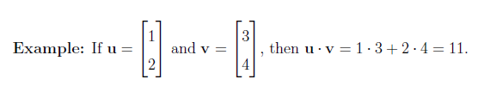
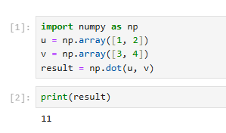
Dot Product of Vectors(Scalar Product)
.
Implementation

Slide 7
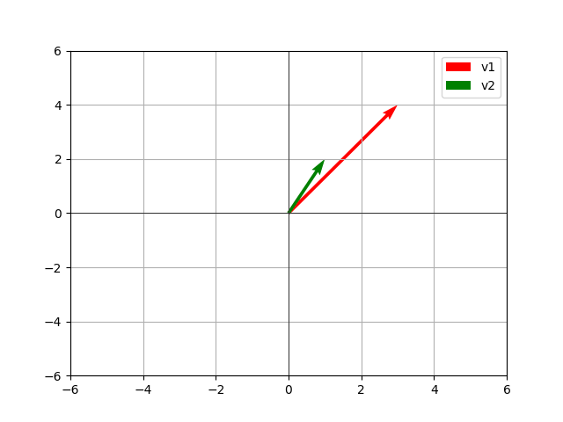
Dot Product of Vectors Visualization
The dot product of two vectors:
u=[1,2] and V=[3,4] is 11
as shown at the right

Slide 8
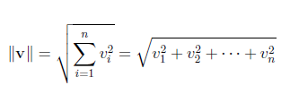
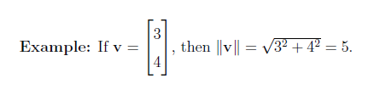
Modulus (Magnitude) of a Vector
The Euclidean norm measures the magnitude (length) of a vector.
It is useful in optimization and distance computations in Machine Learning.

Slide 9
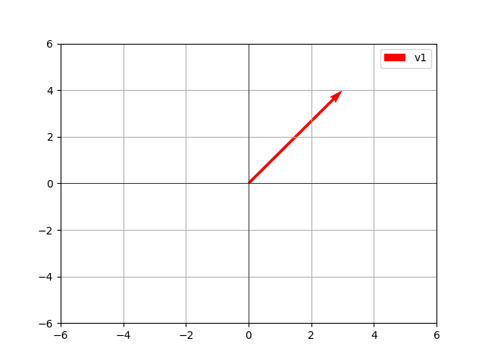
Visualizationof a Vector (Magnitude)
import numpy as np
v = np.array([3, 4])//The np.array() function is used to create a NumPy array from a list of values. In this case, the list [3, 4] represents a 2-dimensional vector (or a point in 2D space).
result = np.linalg.norm(v)//This line calculates the magnitude (or Euclidean norm, or length) of the vector v using the np.linalg.norm() function. np.linalg is a submodule within NumPy that provides linear algebra functions, and norm() is the function for calculating vector norms.
print(result)// 5

Slide 10
Vector Negation
Vector Negation
  The negation of a vector reverses its direction.
  All components of the vector are multiplied by -1.
  If v = [v₁, v₂, ..., vₙ], then -v = [-v₁, -v₂, ..., -vₙ].
Example: If v = [2, -1, 3], then -v = [-2, 1, -3].

Slide 11
Vector Negation
Vector Negation
  The negation of a vector reverses its direction.
  All components of the vector are multiplied by -1.
  If v = [v₁, v₂, ..., vₙ], then -v = [-v₁, -v₂, ..., -vₙ].
Example: If v = [2, -1, 3], then -v = [-2, 1, -3].

Slide 12
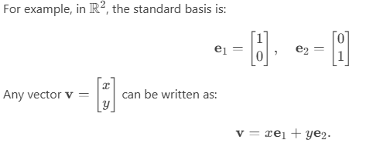
Basis of a Vector Space
What is a Basis?
A basis of a vector space is a set of linearly independent vectors that span the entire space.
Any vector in the space can be uniquely expressed as a linear combination of the basis vectors.

Slide 13
What is a Change of Basis?
A change of basis is the process of expressing the same vector or linear transformation in terms of a different basis.
Suppose we have two bases for a vector space:
  Basis A: {a1,a2,…,an}
  Basis B: {b1,b2,…,bn}
  A vector v can be represented in terms of either basis A or basis B.

Slide 14
Why Change Basis?
Simplification: Some problems are easier to solve in a specific basis.
Diagonalization: In machine learning and physics, changing to a basis where a matrix is diagonal simplifies computations.
Visualization: In computer graphics, changing the basis allows us to rotate, scale, or transform objects.
Dimensionality Reduction: Techniques like PCA (Principal Component Analysis) involve changing the basis to reduce the number of dimensions while preserving important information.

Slide 15
How to Perform a Change of Basis
Let’s say we have a vector vv represented in basis A, and we want to represent it in basis B.
Step 1: Define the Bases
Let vA​ be the coordinates of v in basis A.
Let vB​ be the coordinates of v in basis B.
Step 2: Find the Change of Basis Matrix
The change of basis matrix P transforms coordinates from basis A to basis B.
To construct P, express each vector of basis A in terms of basis B:
P=[a1​​ a2 ​​…​an​​]Here, a1​,a2​,…,an​ are the basis vectors of A expressed in terms of basis B.

Slide 16
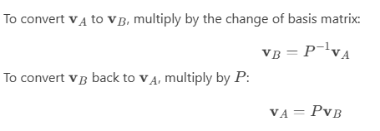
How to Perform a Change of Basis
Step 3: Transform the Vector

Slide 17
Applications of Change of Basis
Principal Component Analysis (PCA): Reduces dimensionality by projecting data onto a new basis of principal components.
Eigen Decomposition: Diagonalizes a matrix by changing to a basis of eigenvectors.
Computer Graphics: Transforms objects between coordinate systems (e.g., world coordinates to camera coordinates).
Quantum Mechanics: Changes the representation of quantum states.

Slide 18
Key Takeaways
A basis is a set of linearly independent vectors that span a vector space.
Change of basis allows us to represent vectors or matrices in terms of a different basis.
The change of basis matrix P transforms coordinates from one basis to another.
Changing basis is useful for simplification, diagonalization, and dimensionality reduction.

Slide 19
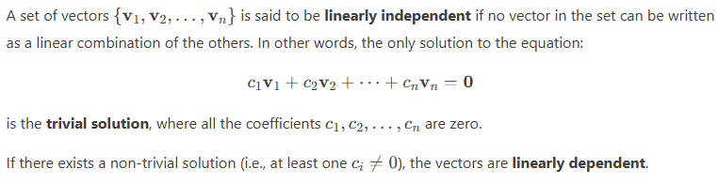
Linear independence
Linear independence is a fundamental concept in linear algebra that describes the relationship between vectors in a vector space. Let’s break it down step by step:

Slide 20
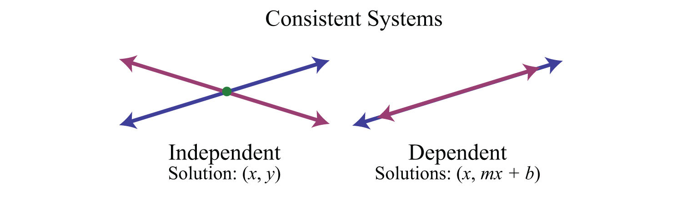
Intuitive Explanation
Linear Independence: The vectors are "independent" in the sense that none of them can be constructed by scaling or adding the others.
Linear Dependence: At least one vector in the set is redundant because it can be expressed as a combination of the others.

Slide 21
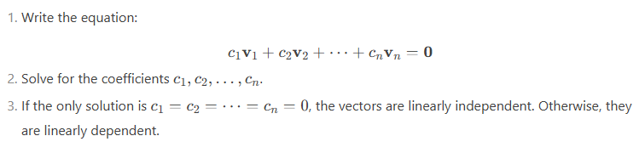
How to Check for Linear Independence
To determine whether a set of vectors is linearly independent:

Slide 22
How to Check for Linear Independence
To determine whether a set of vectors is linearly independent:

Slide 23
Geometric Interpretation
In R2:
  Two vectors are linearly independent if they are not collinear (i.e., they do not lie on the same line).
  Three or more vectors are always linearly dependent in R2.
In R3:
  Three vectors are linearly independent if they do not lie in the same plane.
  Four or more vectors are always linearly dependent in R3.

Slide 24
Applications
Basis Selection: Linear independence is used to determine if a set of vectors can form a basis for a vector space.
Solving Systems of Equations: Linear independence helps determine if a system has a unique solution.
Machine Learning: Feature vectors in datasets must be linearly independent to avoid redundancy.

Slide 25
How to Identify a Linearly Independent Basis
To identify a linearly independent basis for a vector space:
Start with a set of vectors that span the space.
Check for linear independence:
  If the vectors are linearly independent, they form a basis.
  If they are linearly dependent, remove redundant vectors until the remaining set is linearly independent.

Slide 26
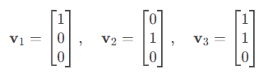
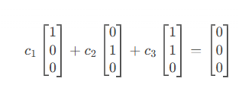
Example: Identifying a Basis in R3
Step 1: Start with a Set of Vectors
Consider the following vectors in R3:
Step 2: Check for Linear Independence
Set up the equation:
c1​v1​+c2​v2​+c3​v3​=0
This gives:

Slide 27
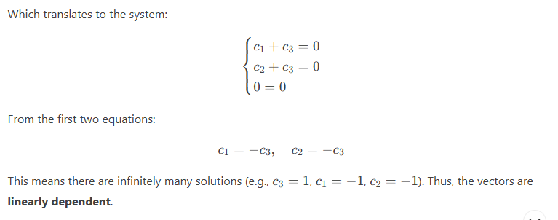
Example: Identifying a Basis in R3

Slide 28
Example: Identifying a Basis in R3
Step 3: Remove Redundant Vectors
Since v3​=v1​+v2​, we can remove v3​. The remaining vectors v1​ and v2​ are linearly independent and span the subspace of R3 where the third component is 0.
Step 4: Identify the Basis
The set {v1​,v2​} is a basis for the subspace of R3 where the third component is 0. The dimension of this subspace is 2.

Slide 29
Relating Basis to Dimensionality
The number of vectors in a basis equals the dimension of the space.
For example:
In R2, any basis has 2 vectors, and the dimension is 2.
In R3, any basis has 3 vectors, and the dimension is 3.
In a subspace, the dimension is the number of vectors in its basis.

Slide 30
Summary
Basis: A set of linearly independent vectors that span a space.
Linearly Independent Basis: Ensures that no vector is redundant.
Dimensionality: Defined by the number of basis vectors.
Change of Basis: Transforming vector coordinates from one basis to another.
Applications: Graphics, Physics, Machine Learning.

Slide 31
References
Strang, G. (2016). Introduction to Linear Algebra. Wellesley-Cambridge Press.
Lay, D. C. (2019). Linear Algebra and Its Applications. Pearson.
NumPy Documentation: https://numpy.org/doc/
Matplotlib Animation Guide: https://matplotlib.org/stable/api/animation_api.html

Slide 32

















الشراكات العالمية

Slide 33
شــــــكــــرًا لكــــــم
THANK YOU

